Slide 1
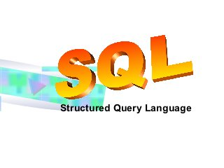

Slide 2
What is Database?
A database is a collection of information that is organized so that it can easily be accessed,managed and updated.

Slide 3
What Database consists of?
Database is collection of Tables
A table is a collection of related data entries and it consists of columns and rows
Each row is treated as Record

Slide 4
What is SQL?
SQL stands for Structued Query Language
SQL is used to communicate with a database
SQL can execute queries against a database
SQL can retrieve data from a database
SQL can insert records in a database
SQL can update records in a database
SQL can delete records from a database

Slide 5
WHAT IS SQL?
SQL is a data manipulation language.
SQL is not a programming language.
SQL commands are interpreted by the DBMS engine.
SQL commands can be used interactively as a query language within the DBMS.
SQL commands can be embedded within programming languages

Slide 6
SQL
SQL can create new databases
SQL can create new tables in a database
SQL can delete records from a database
SQL can create views in a database

Slide 7
DBMS INTRODUCTION
What is Database Management System?
It is a software through which we execute SQL queries
There are many such databases like- Oracle, Microsoft SQL Server, SQLite and many others

Slide 8
MYSQL
MYSQL is one of the Database management System
It is open source dbms and you can use it for free
Runs on various platforms and have good performance results
We will studying based on MYSQL

Slide 9
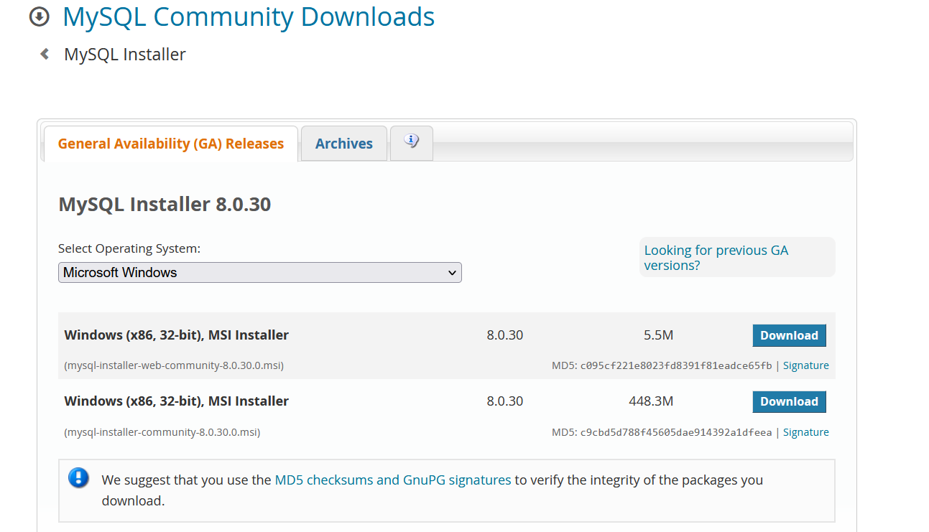
DOWNLOAD MYSQL
https://dev.mysql.com/downloads/windows/installer/

Slide 10
INSTALLATION STEPS

Slide 11
CREATE DATABASE
DATABASE IS LIKE A LAND FOR CONSTRUCTION OF BUILDING
WITHOUT LAND YOU CANNOT COSNTRUCT BUILDING
TO CREATE DATABASE USE BELOW QUERY
CREATE DATABASE DATABASE_NAME
FOR EG: CREATE DATABASE EMP;

Slide 12
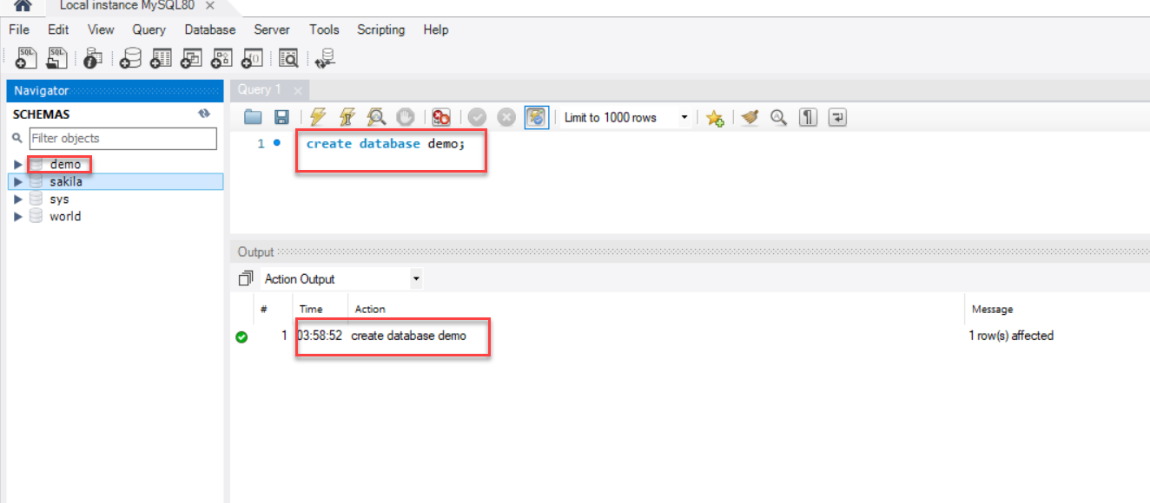
DATABASE

Slide 13
CREATE TABLE
FIRST MENTION WHICH DATABASE , TABLE SHOULD BE CREATED
SYNTAX: USE DATABASE_NAME;

Slide 14
CREATE TABLE

Slide 15
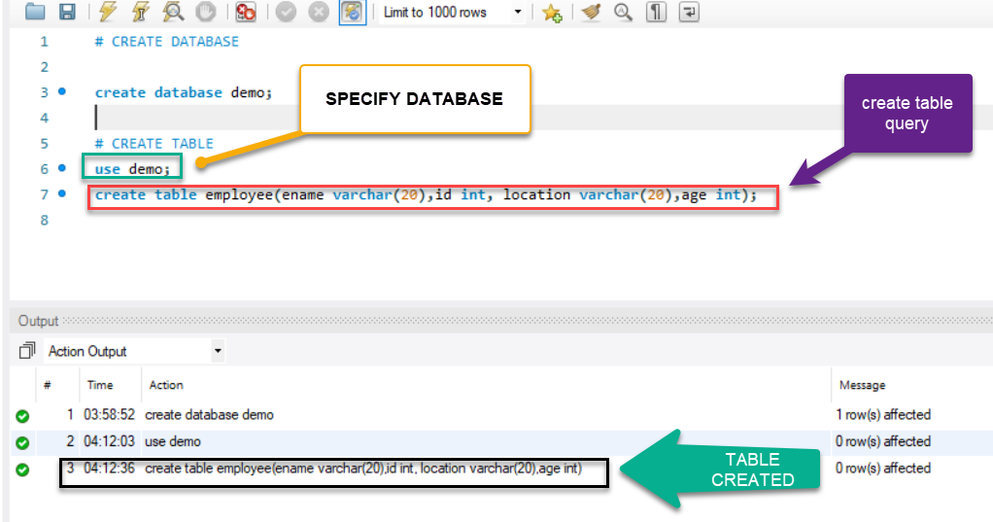
TABLE CREATION

Slide 16
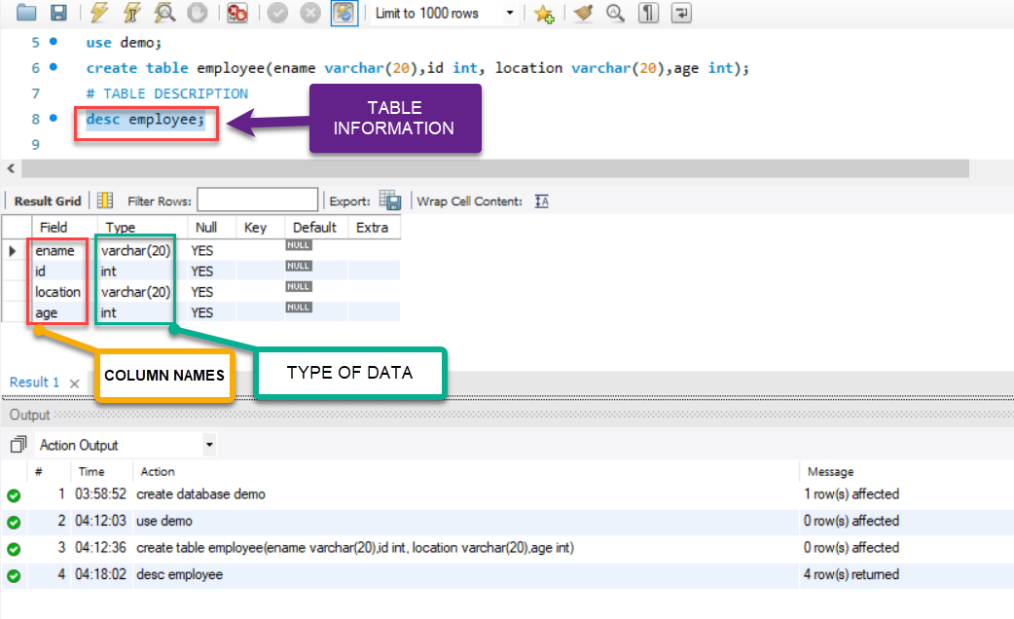
TABLE INFORMATION

Slide 17
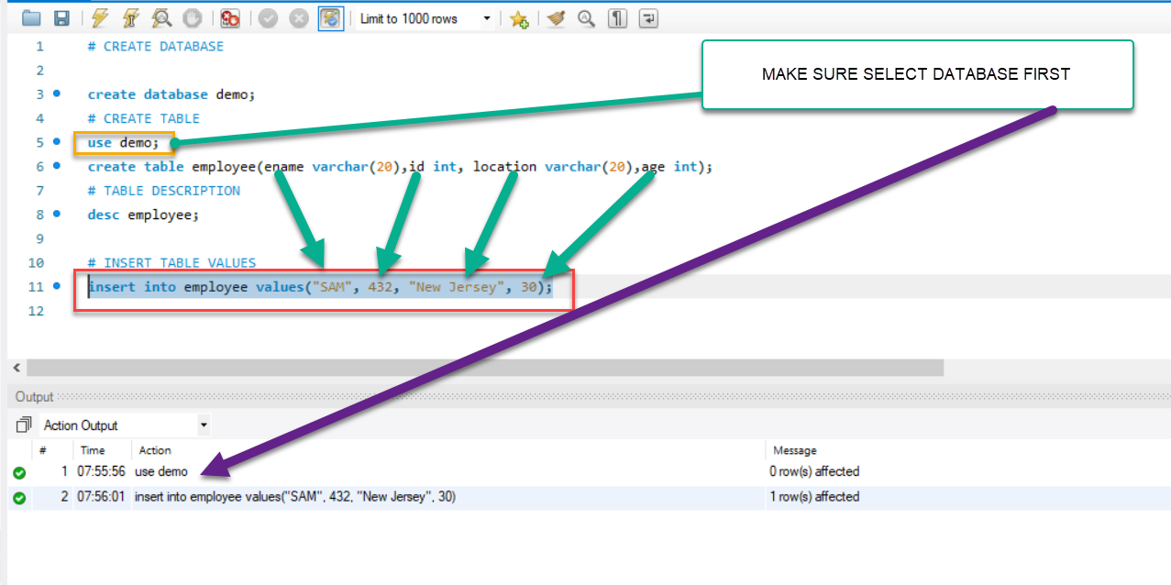
INSERT VALUES INTO TABLE

Slide 18
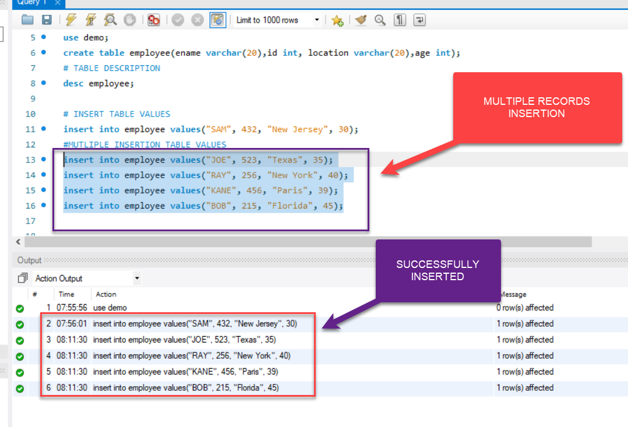
MUTLIPLE RECORD INSERTION

Slide 19
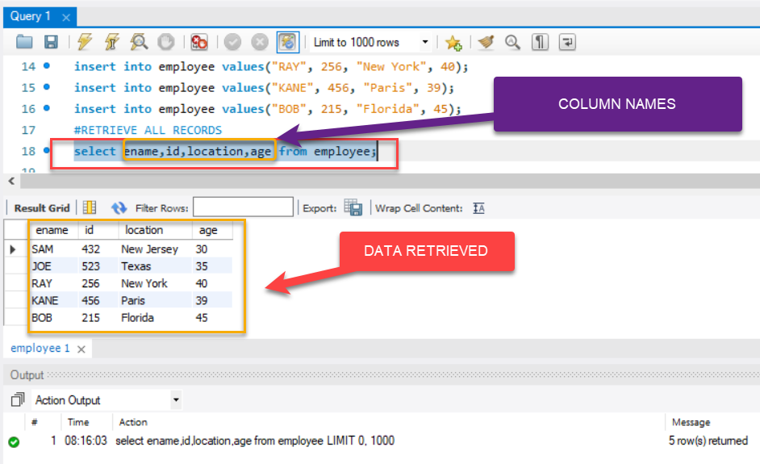
RETRIEVE ALL RECORDS

Slide 20
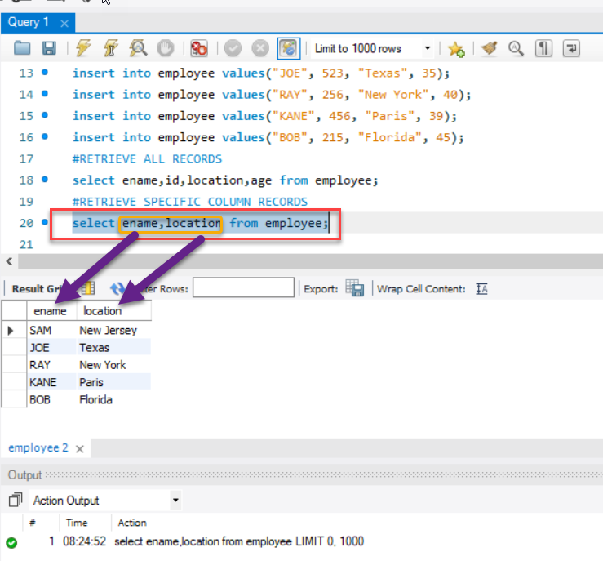
RETRIEVE SPECIFIC COLUMN RECORDS

Slide 21
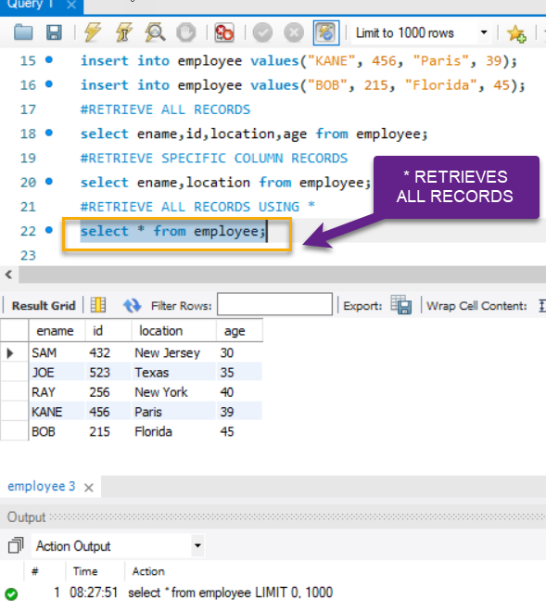
RETRIEVE ALL RECORDS USING *

Slide 22
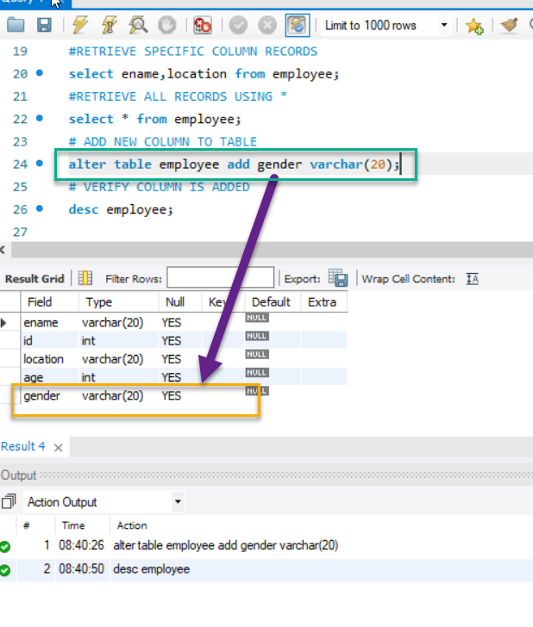
ADD COLUMN TO EXISTING TABLE
SYNTAX
ALTER TABLE TABLE_NAME ADD COLUMN_NAME DATATYPE;

Slide 23
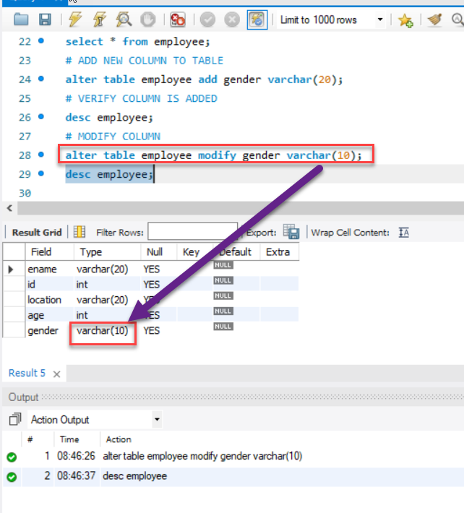
MODIFY COLUMN
SYNTAX
ALTER TABLE TABLE_NAME MODIFY COLUMN_NAME DATATYPE;

Slide 24
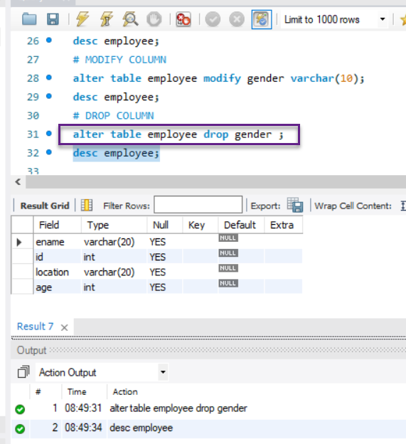
DROP COLUMN
SYNTAX
ALTER TABLE TABLE_NAME DROP COLUMN_NAME ;

Slide 25
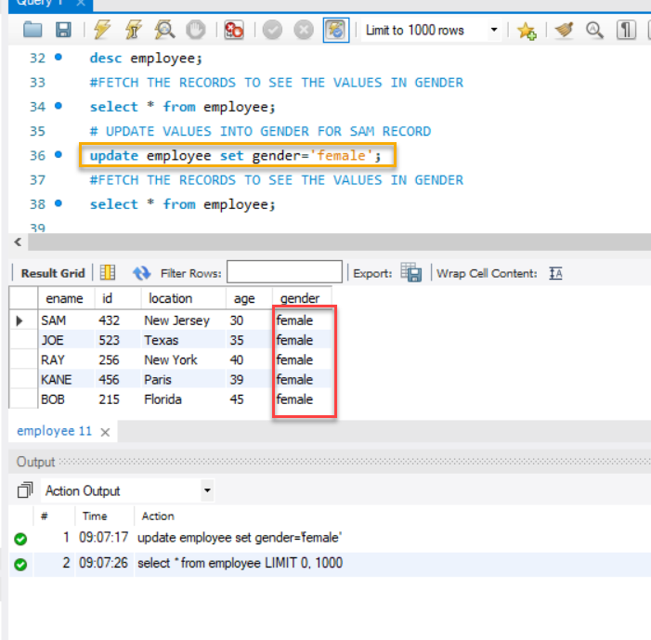
ADD VALUES(ROWS) TO COLUMN
SYNTAX
UPDATE TABLE TABLE_NAME SET COLUMN_NAME= VALUE
NOTE: IF WE DONT MENTION WHERE CONDITION ALL COLUMN VALUE WILL BE UPDATED

Slide 26
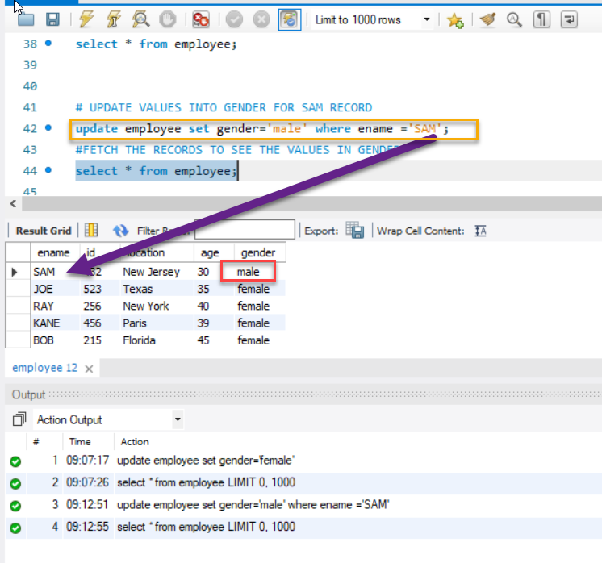
ADD VALUES(ROWS) TO SPECIFIC COLUMN
SYNTAX
UPDATE TABLE TABLE_NAME SET COLUMN_NAME= VALUE WHERE COLUMN_NAME=’VALUE’;
NOTE: IF WE DONT MENTION WHERE CONDITION ALL COLUMN VALUE WILL BE UPDATED

Slide 27
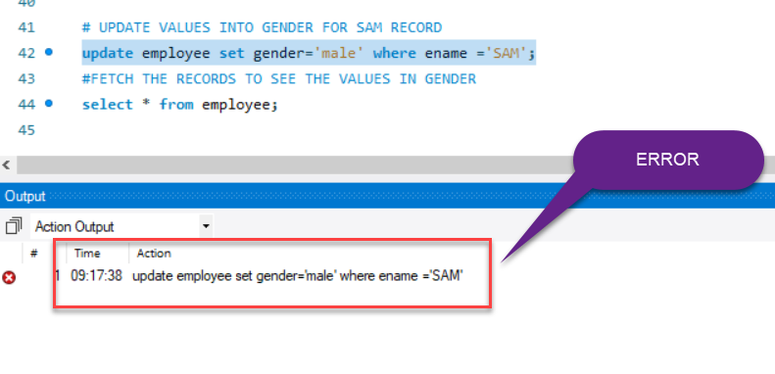
ERROR ON UPDATE

Slide 28
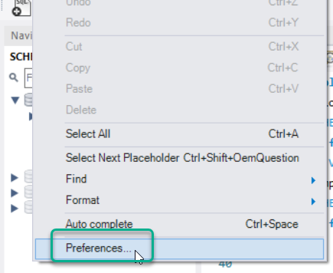
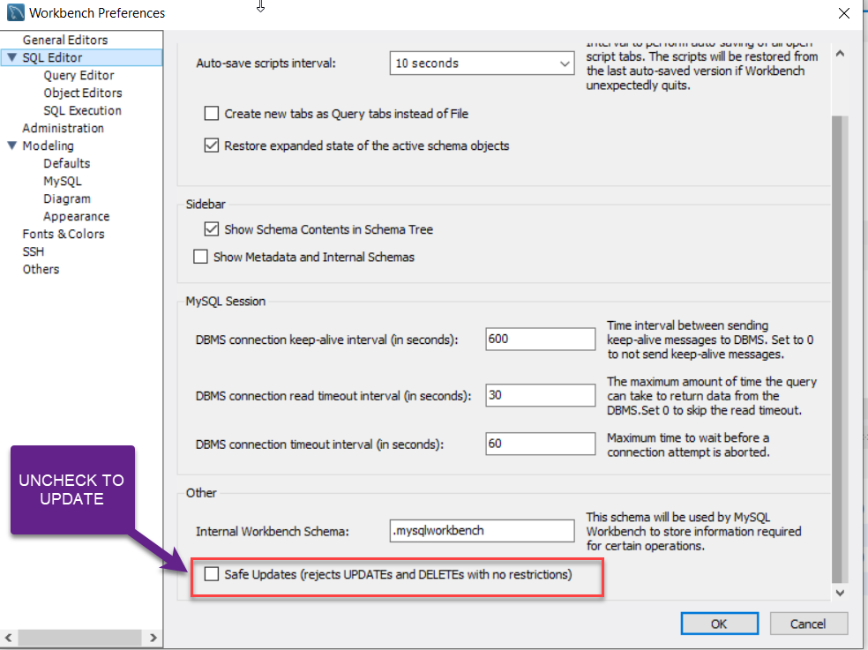
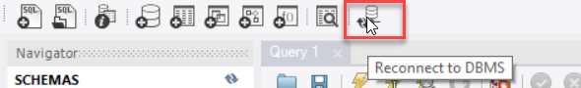
SOLUTION
EDIT -> PREFERENCES -> SQL Editor -> uncheck safe Updates-> OK-> Reconnect to DBMS

Slide 29
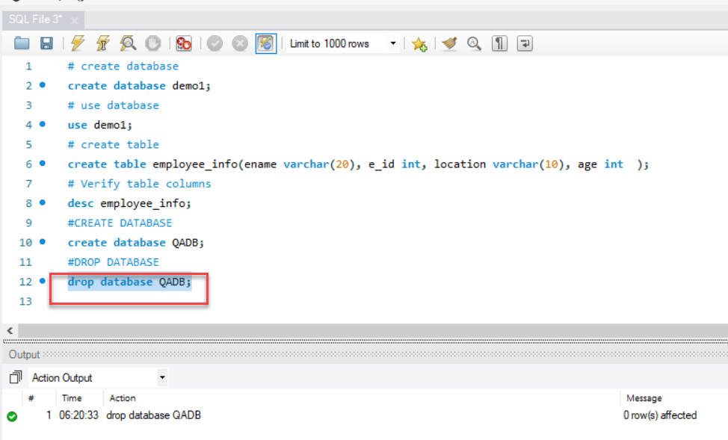
DROP DATABASE
SYNTAX
DROP DATABASE DATABASE_NAME;

Slide 30
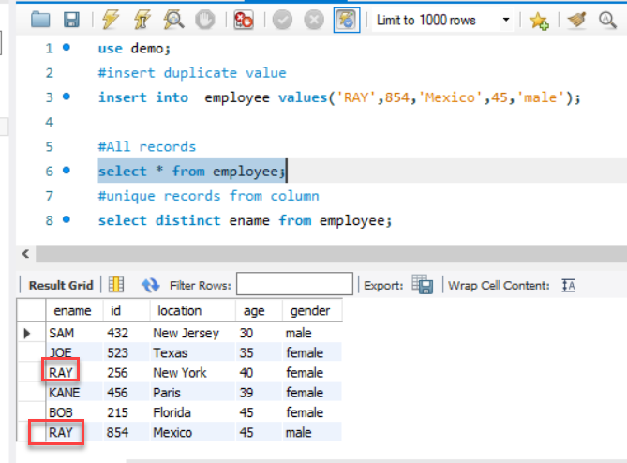
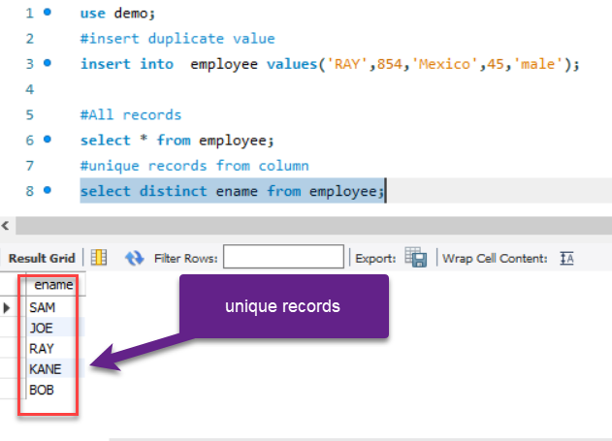
HOW TO GET UNQUE VALUES FROM COLUMN
Solution: If we need to find unique values from column we need to use ‘distinct’ keyword
Syntax: select distinct column_name from table;

Slide 31
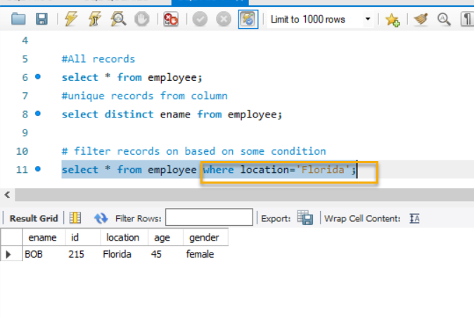
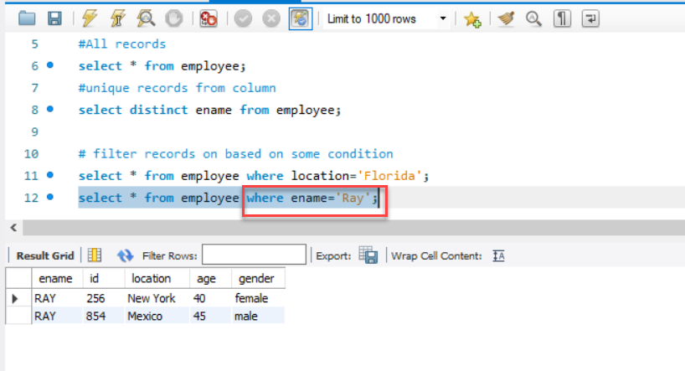
WHERE CONDITION
Syntax: select * from Table_Name where column_name=’value’;

Slide 32
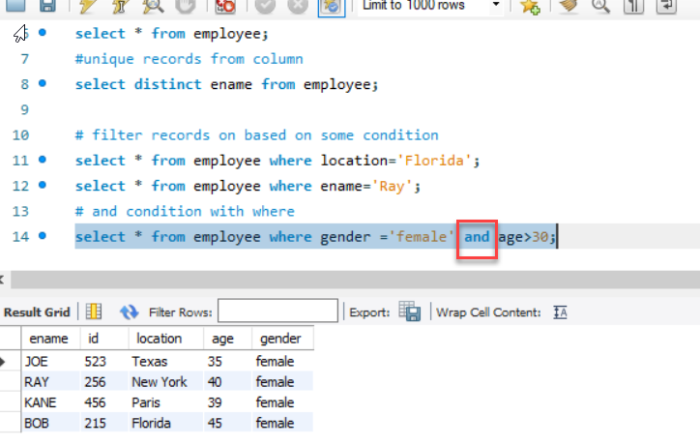
AND OPERATOR

Slide 33
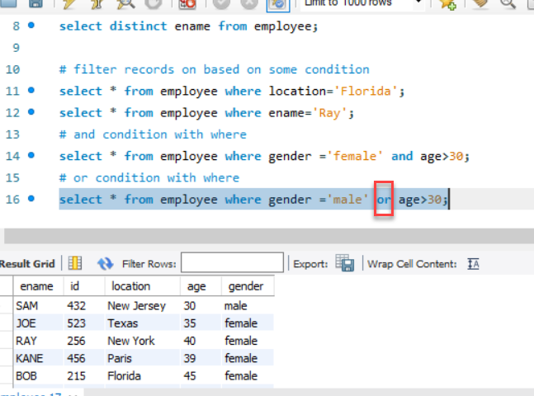
OR OPERATOR

Slide 34
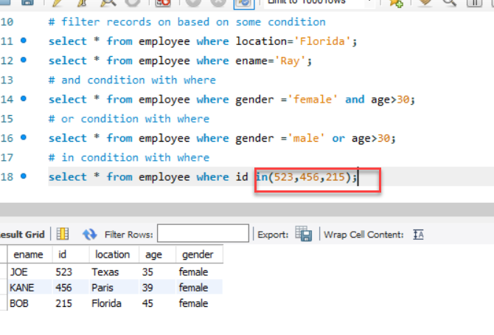
IN OPERATOR

Slide 35
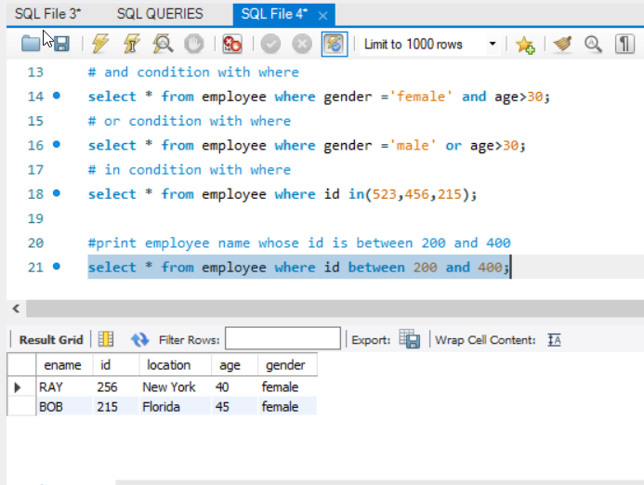
BETWEEN OPERATOR

Slide 36
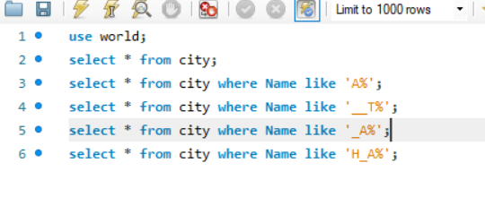
REGULAR EXPRESSIONS
% REPRESENTS ANY NUMBER OF CHARACTER
_ REPRESENTS ONE/SINGLE CHARACTER
NOTE: TO USE REGULAR EXPRESSION ALWAYS USE WITH LIKE

Slide 37
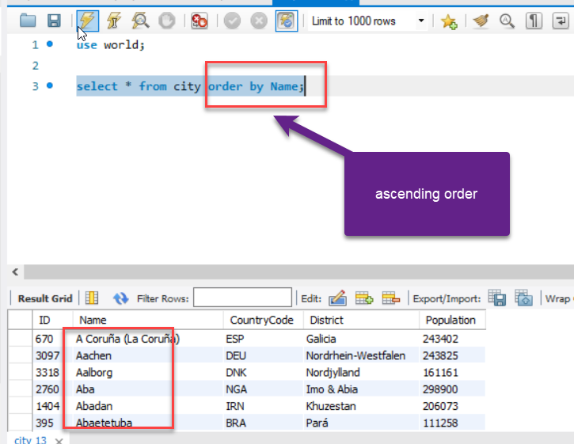
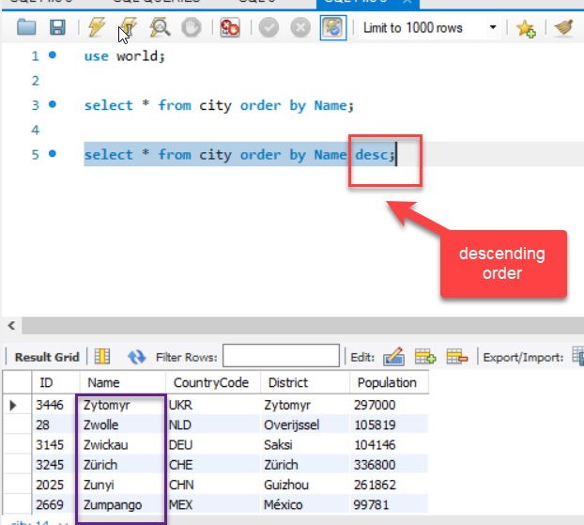
SORT

Slide 65
WHAT IS SQL?
SQL is a data manipulation language.
SQL is not a programming language.
SQL commands are interpreted by the DBMS engine.
SQL commands can be used interactively as a query language within the DBMS.
SQL commands can be embedded within programming languages

Slide 66
3 Types of SQL Commands
Data Definition Language (DDL):
Commands that define a database - Create, Alter, Drop
Data Manipulation Language (DML)
Commands that maintain and query a database.
Data Control Language (DCL)
Commands that control a database, including administering privileges and committing data.

Slide 67
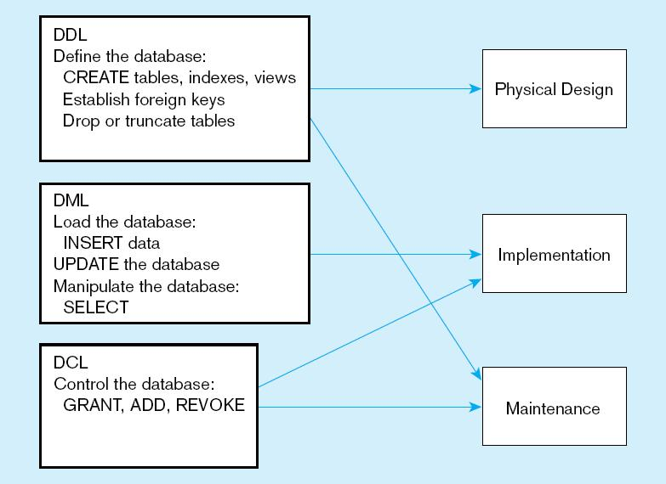
DDL, DML, DCL, and the database development process

